Slide 1
Vision-Based Security System: Enforce Campus Security Through ID Card Ribbon Detection
Faysal Ahmad Patwary
ID: 221-15-4699
Esrat Jahan Eva
ID: 221-15-4690
Department of CSE
Daffodil International University
Md. Jahidul Alam
Lecturer
Department of CSE
Daffodil International University

Slide 2
Outline
Introduction
Objective
Background Study
Gap Analysis
Data Collection
Methodology
Results & Analysis
Novelty of the Work
Conclusion
References

Slide 3
Introduction
Campus security relies on identifying individuals by their roles: Student, Teacher, or Admin.
Currently, role verification is done manually by inspecting ID card ribbons.
This process is inefficient and prone to human error.
Our research uses YOLOv11 to automate ribbon-based role detection.
The goal is to build a lightweight, accurate, and real-time detection system.

Slide 4
Objective
Install a vision system which tracks ID card ribbons in real time.
Assign people the roles of student, teacher, and administration (according to the color of ribbon).
Train YOLOv11s and YOLOv11m with different epoch to find the most accurate model.
Reduce manual verification and human error.
Provide a scalable and cost-effective security solution for institutions.

Slide 5
Background Study
Authors | Study Focus | Methodology | Results
Aung (2022-2023) | Campus Security with Face Recognition | Haar Cascade, LBPH, Student & Staff Database | 90% accuracy in time-in/time-out automation for campus identification.
Bourdima et al. (2024) | Real-time Face Recognition for Security | MTCNN, Inception-ResNet-v1, Deep Learning | High accuracy in detecting unauthorized access at institutions.
Deepalakshmi et al. (2023) | Smart Campus Surveillance with Deep Learning | YOLO, CNN for Identity Card & Face Detection | YOLOv7 achieved 91.3% precision in detecting ID card wearers.
Jinglong (2024) | Smart Card Behavioral Analysis for Campus Management | Machine Learning, Smart Card Logs | Real-time behavioral analysis, enhanced safety management.
Sasirekha et al. (2024) | IoT & CNNs for Campus Safety and Emergency Response | IoT, CNNs, AI-based Emergency Response | Real-time monitoring, effective anomaly detection for campus safety.

Slide 6
Gap Analysis
Existing systems focus on face recognition or full ID scanning, not ID ribbon detection.
No current research targets campus-specific role classification using visual ribbons.
Available models are often too large for real-time or edge device deployment.
Lack of lightweight, low-cost solutions for automated role verification in universities.

Slide 7
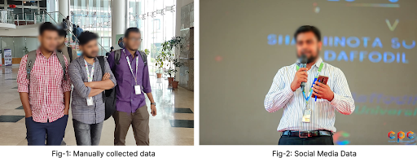
Data Collection
The data collection process involved capturing real images from various campus locations along with additional samples gathered from publicly available social media posts where individuals were visibly wearing ID ribbons. This ensured a diverse dataset covering different lighting conditions, backgrounds, distances, and natural human movements, providing a realistic foundation for training the ribbon detection model.

Slide 8
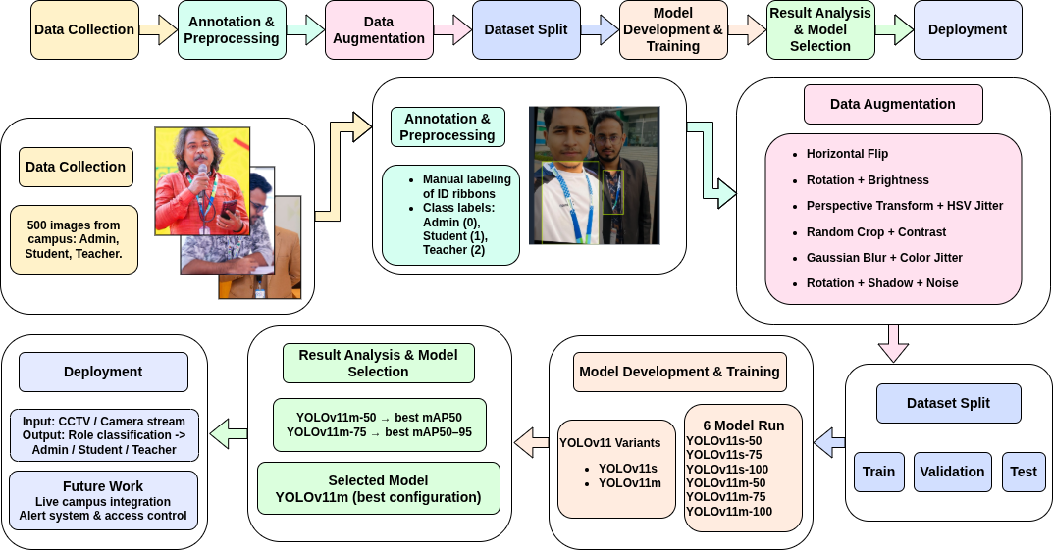
Methodology

Slide 9
Result and Analysis
Model Varient | Epochs | mAP50 | mAP50-95
YOLOv11s | 50 | 0.88096 | 0.53260
YOLOv11s | 75 | 0.87833 | 0.50929
YOLOv11s | 100 | 0.89630 | 0.52460
YOLOv11m | 50 | 0.90233 | 0.52382
YOLOv11m | 75 | 0.90045 | 0.54208
YOLOv11m | 100 | 0.88616 | 0.48777

Slide 10
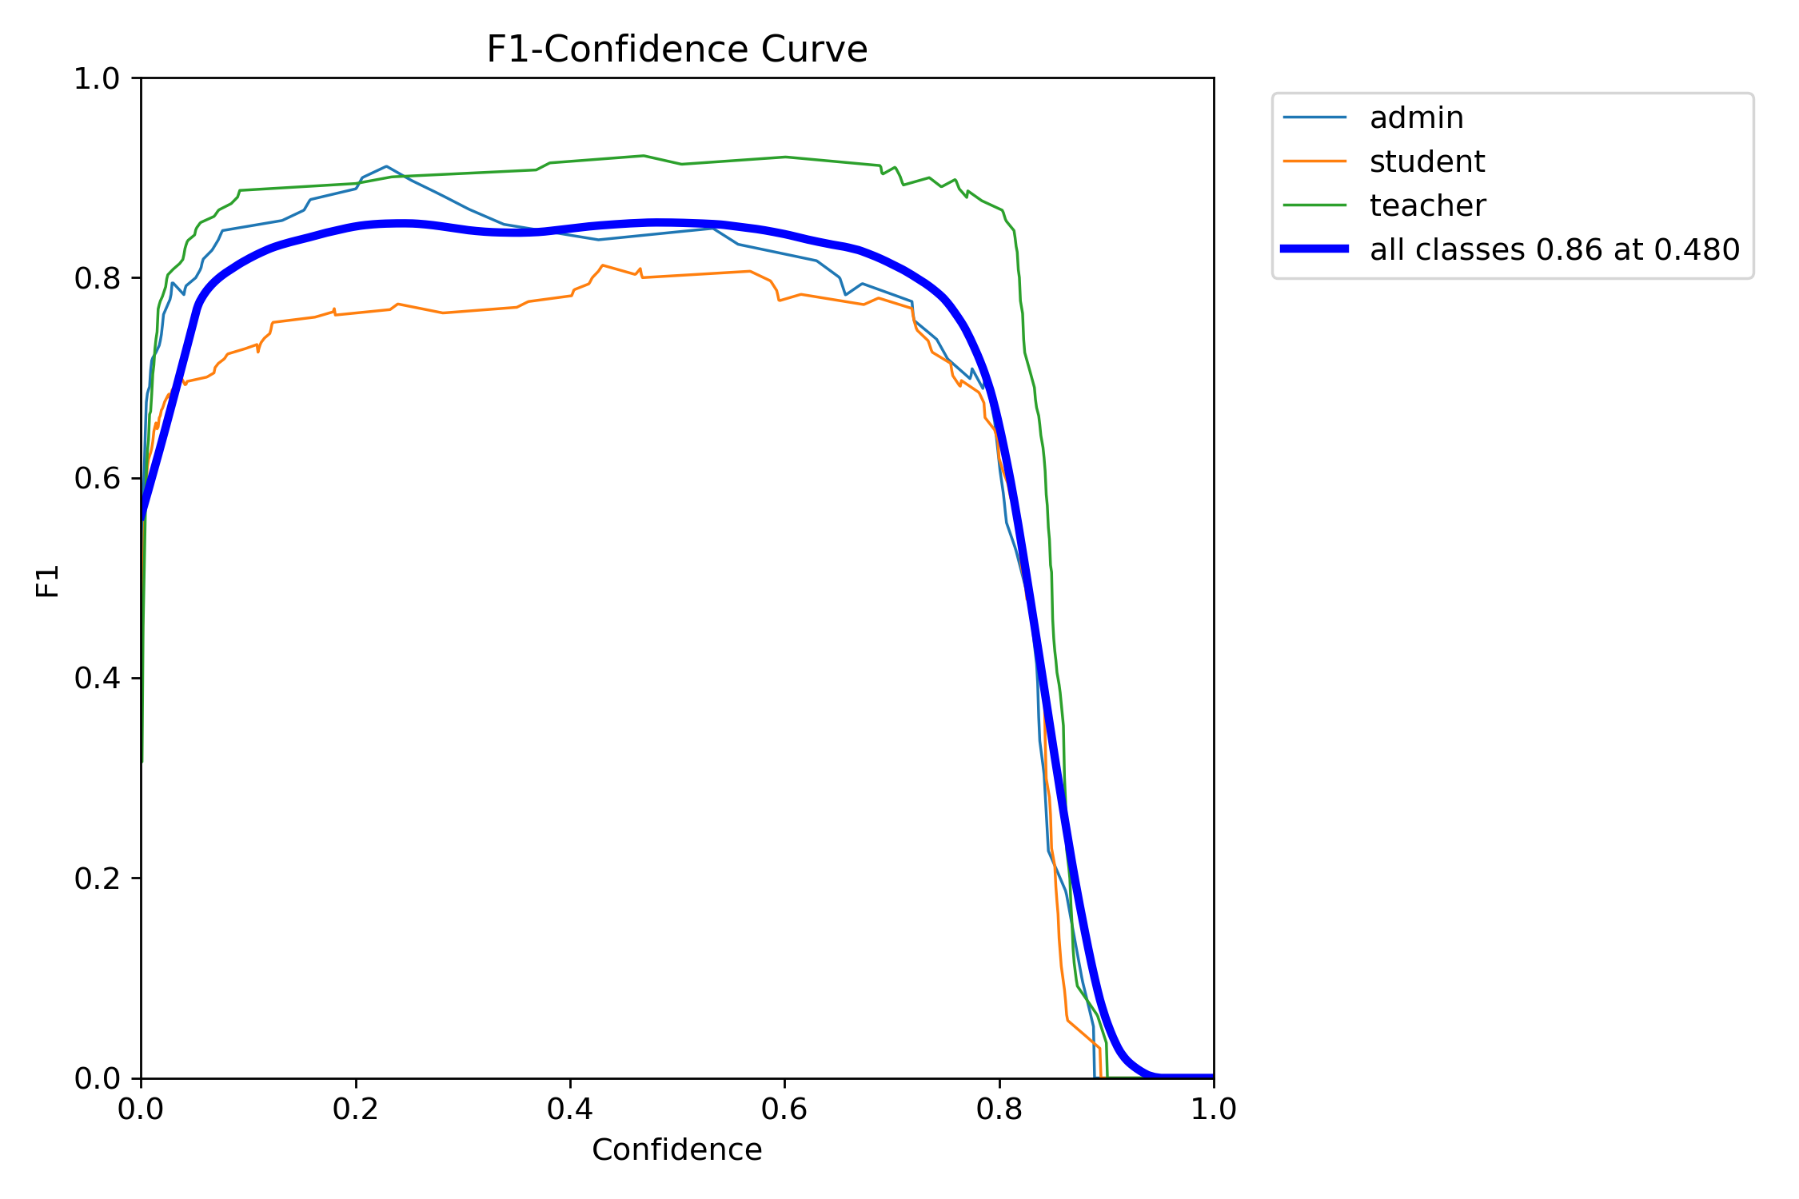
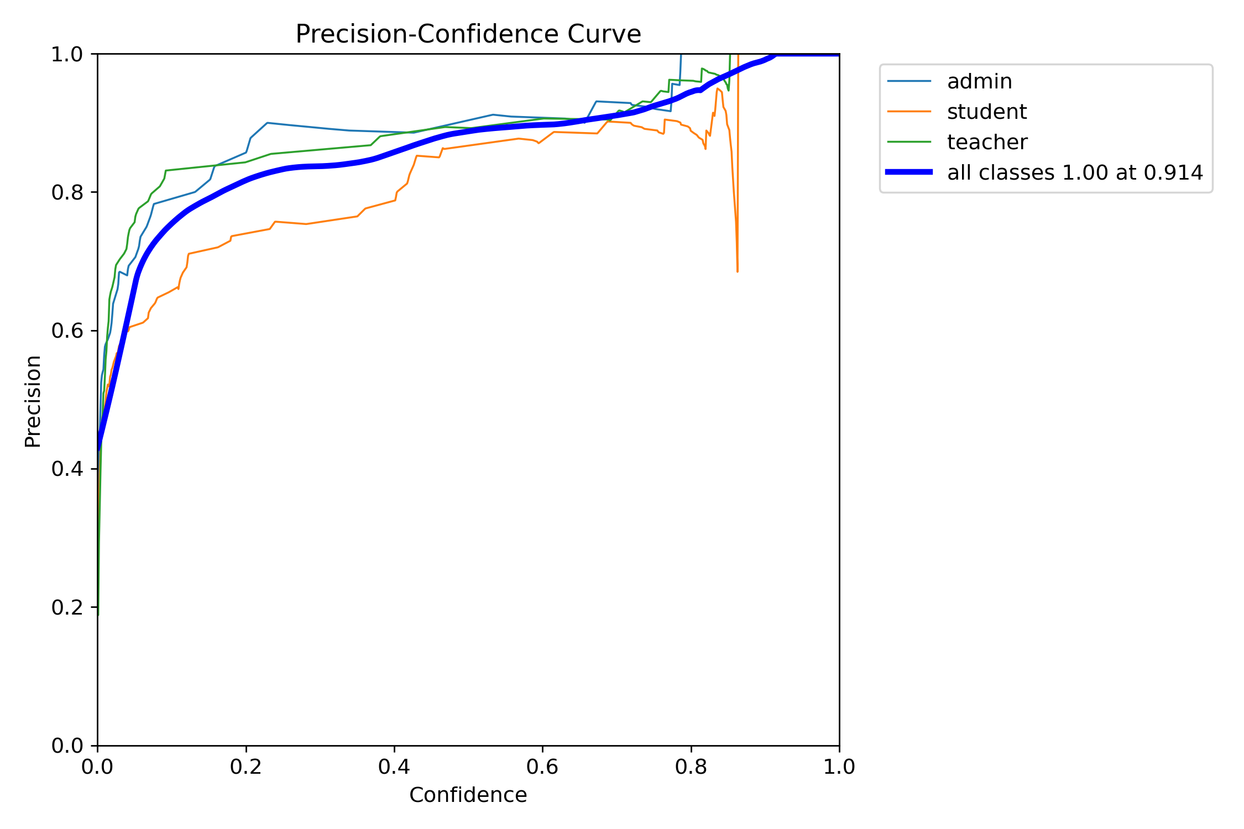
Result and Analysis

Slide 11

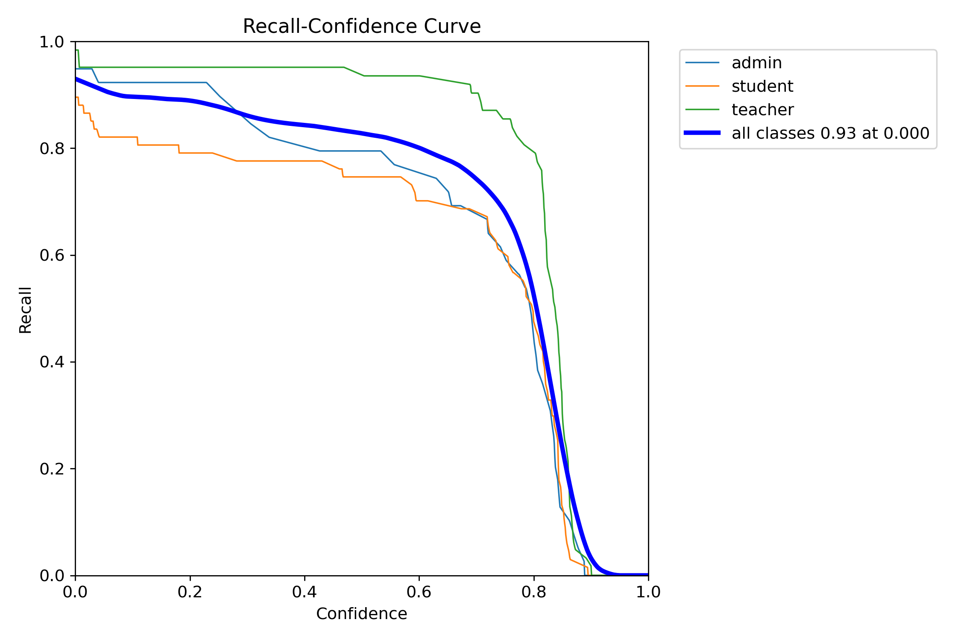
Result and Analysis

Slide 12
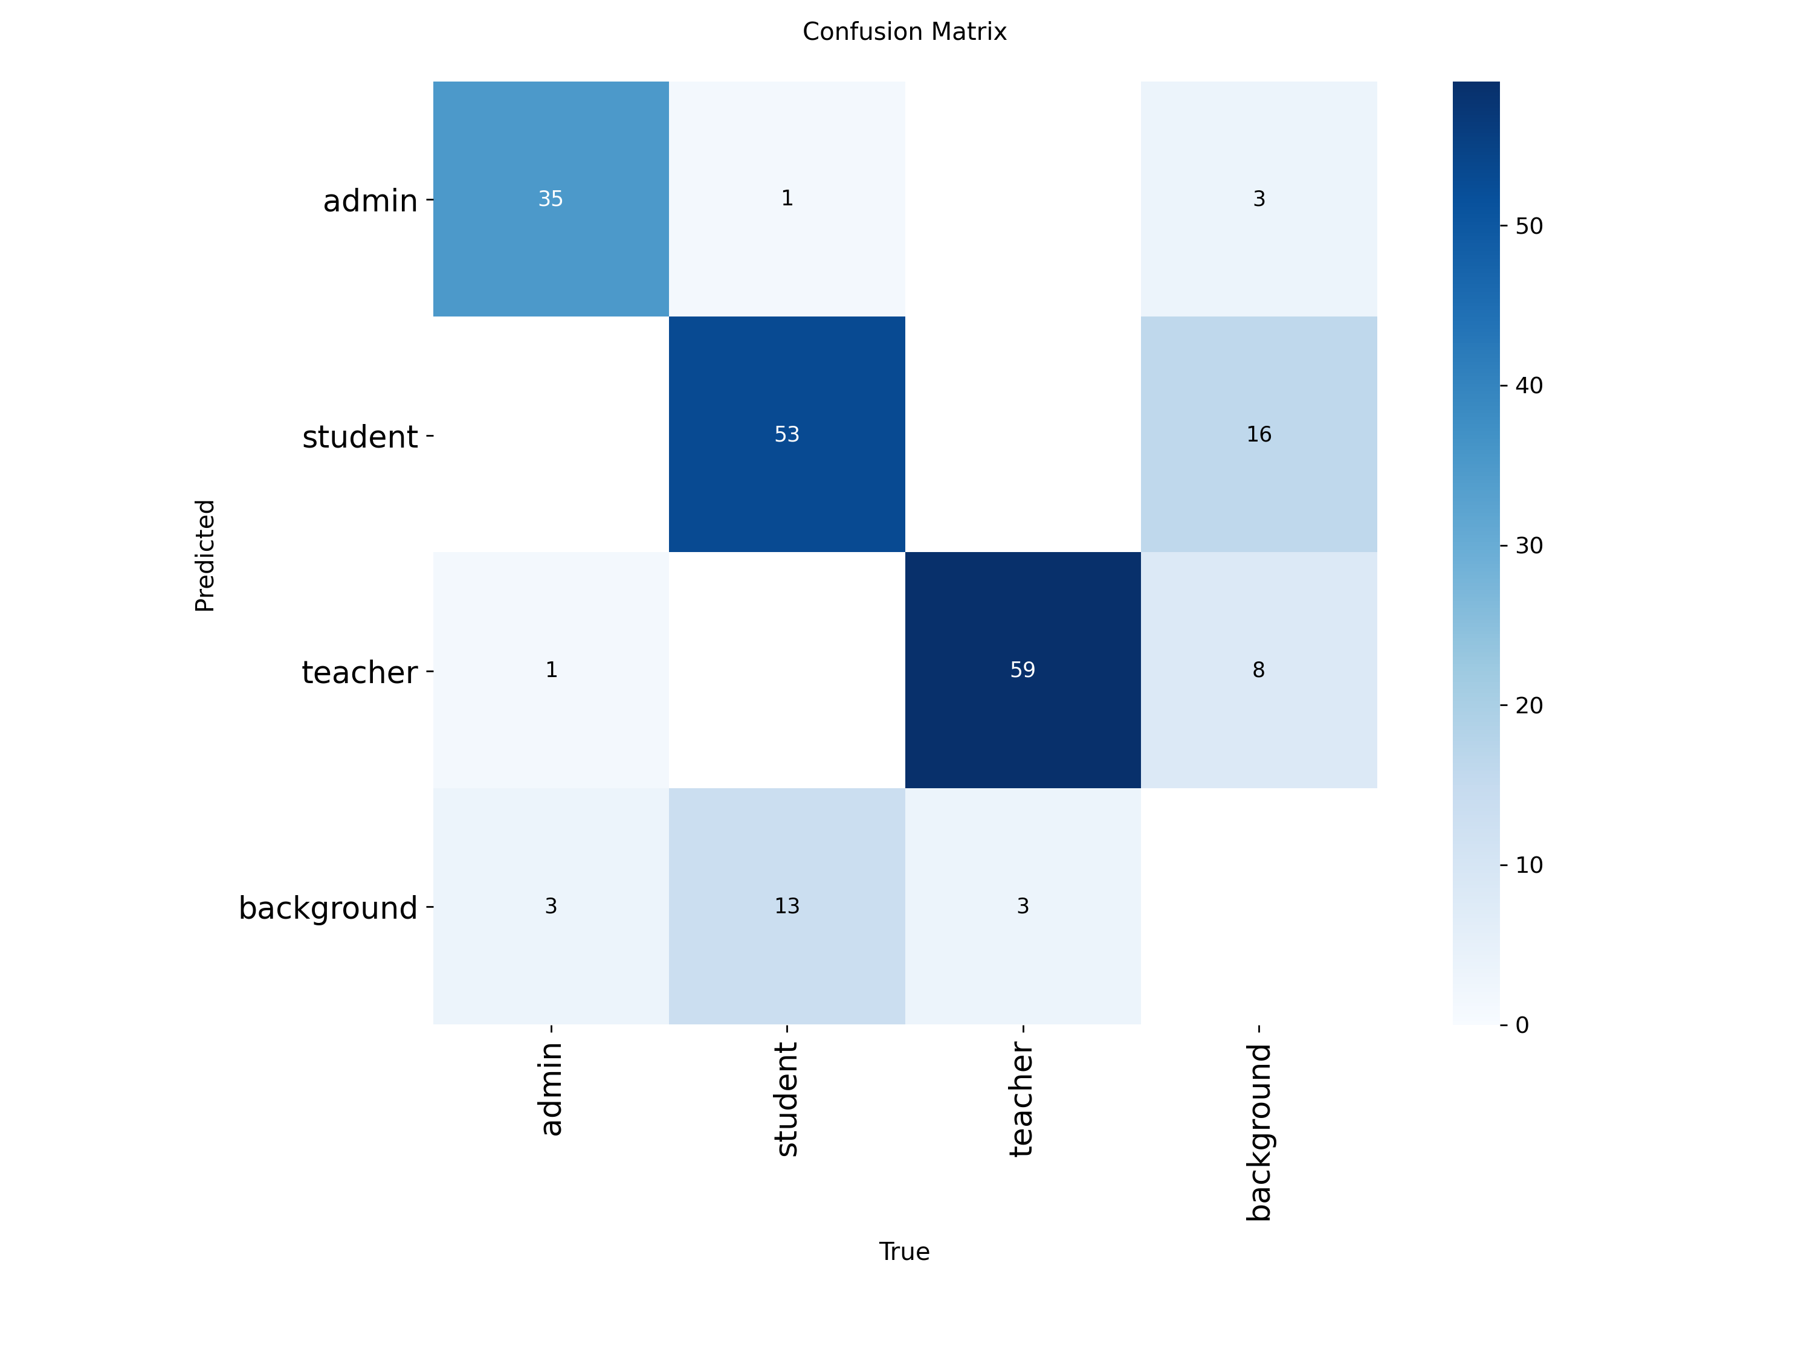
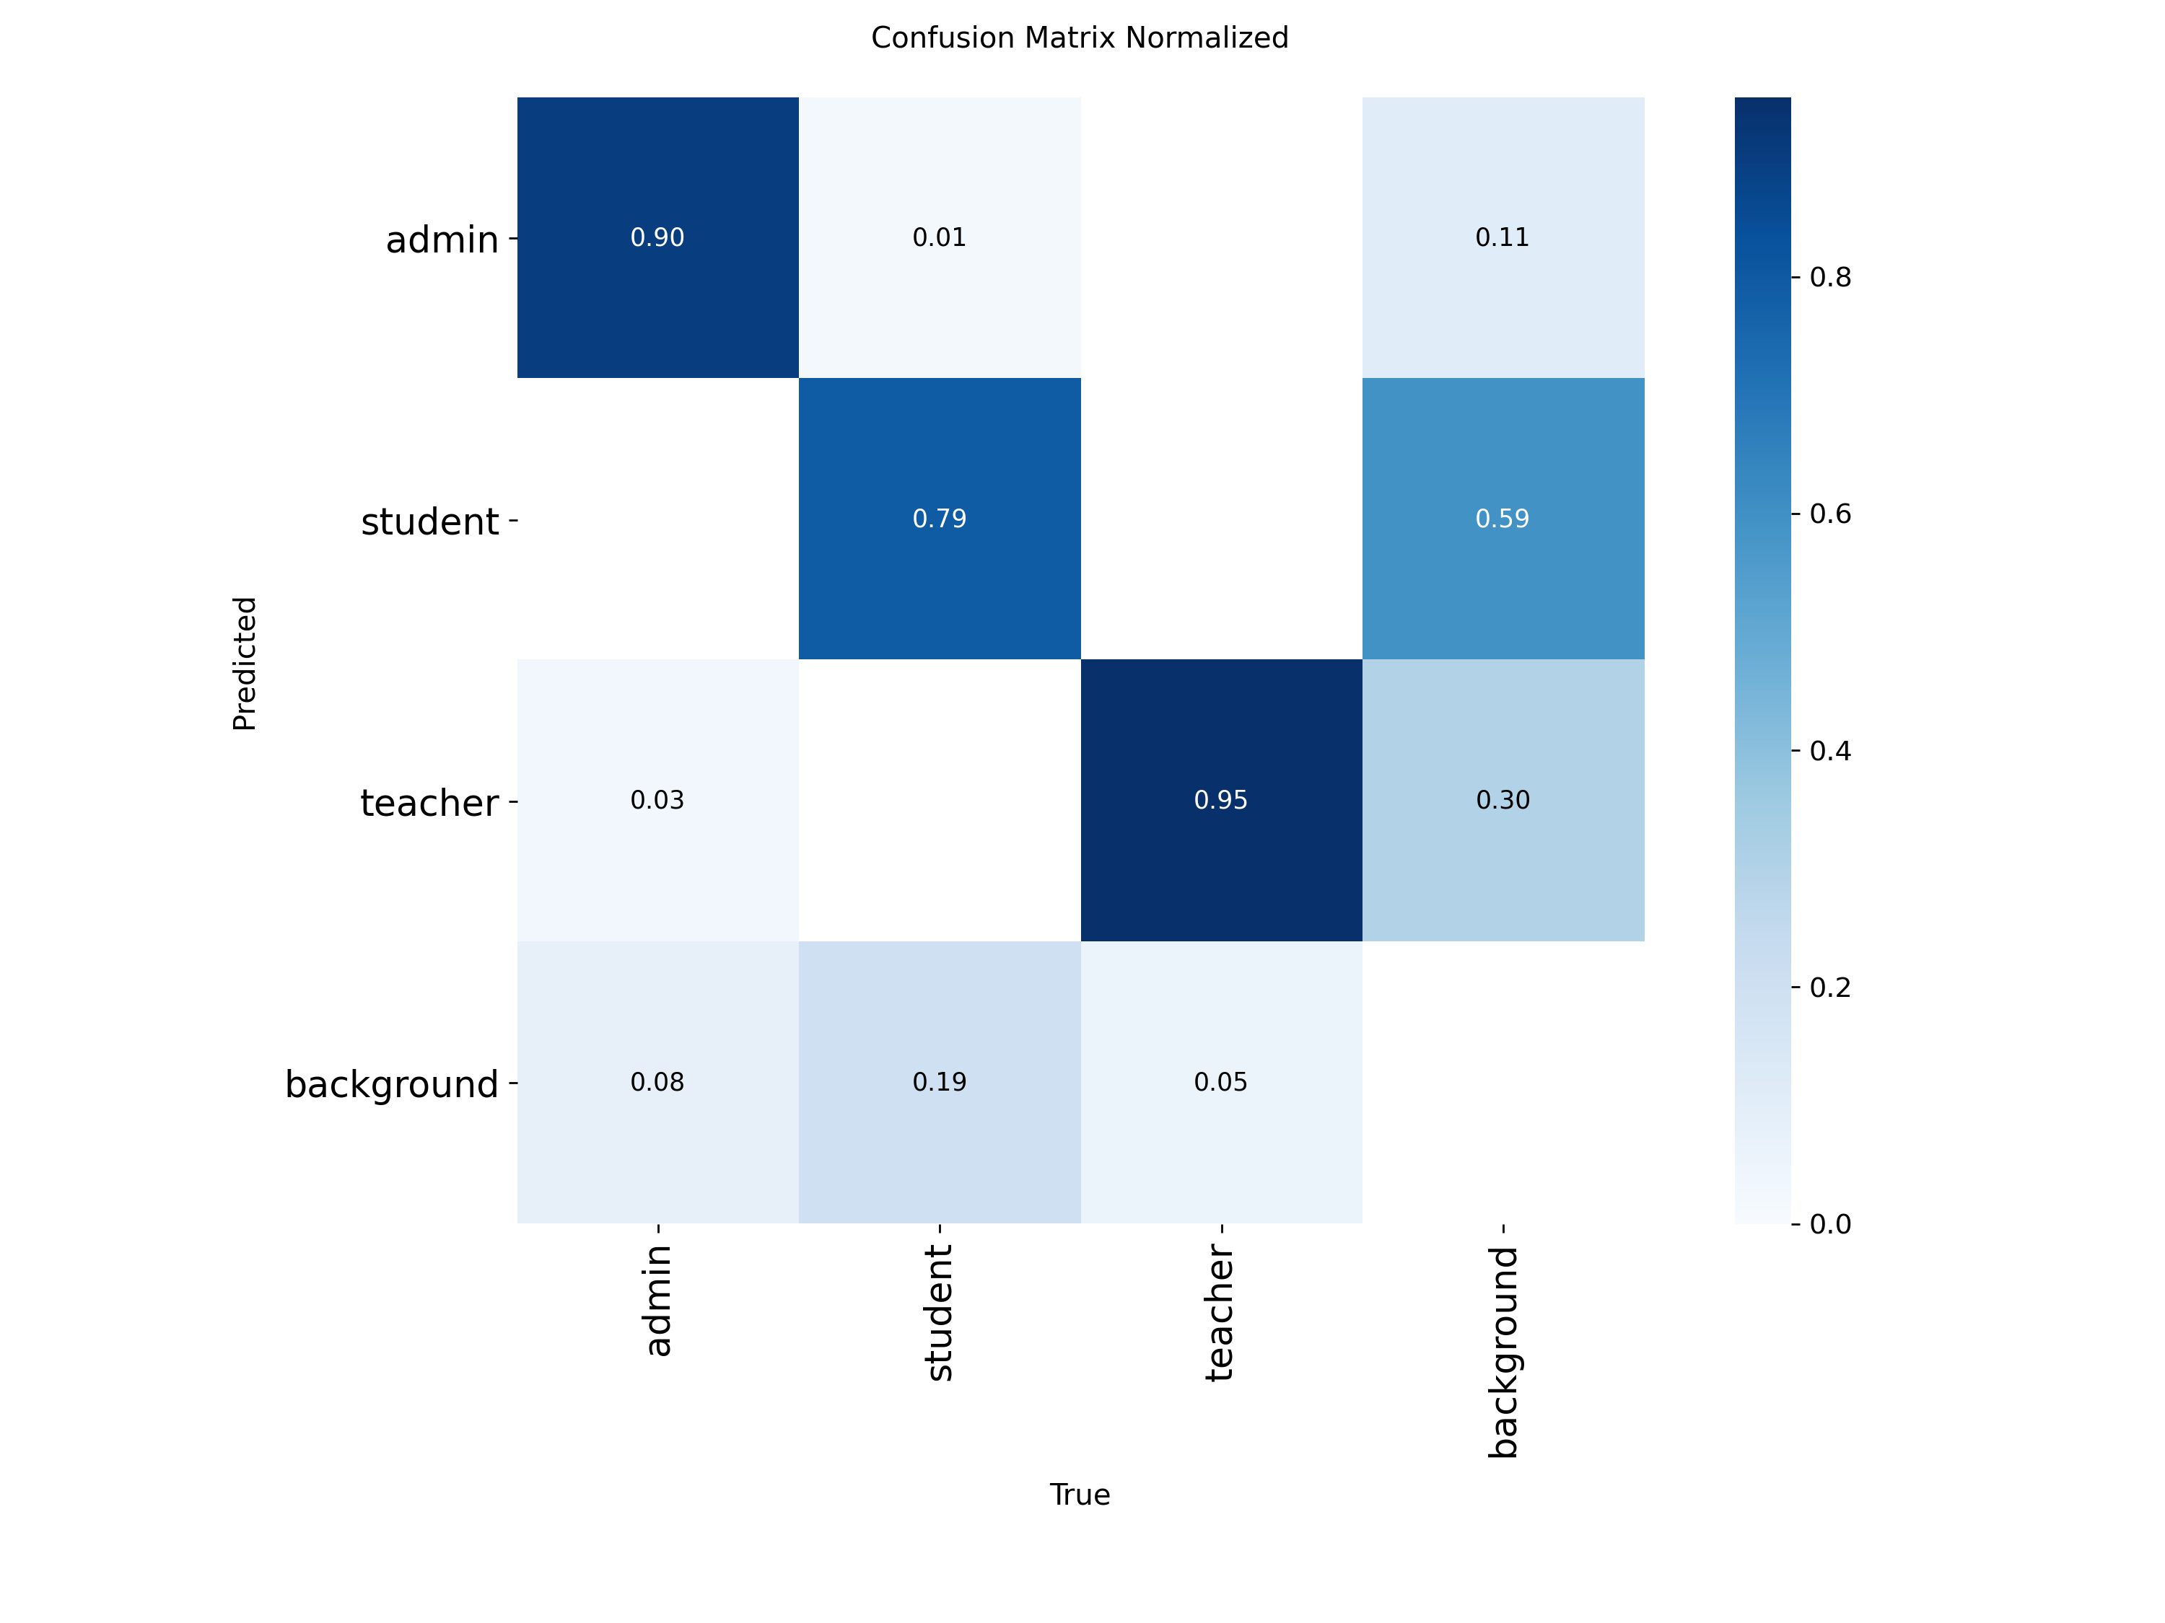
Result and Analysis

Slide 13

Result and Analysis

Slide 14
Novelty of the Work
Custom campus dataset with manually annotated ribbon regions.
First campus security system that uses ID ribbon color for role identification instead of face or full ID scanning.
Provides a privacy-friendly alternative to biometric face recognition; no facial data is stored.
Designed as a lightweight, deployable system suitable for GPUs and edge devices.

Slide 15
Conclusion
Our project successfully developed a vision-based system that can detect ID ribbons and identify campus roles in real time. The system reduces manual checking, improves accuracy, and offers a privacy-friendly alternative to face recognition. Through a custom primary dataset and extensive model comparison, we achieved reliable performance suitable for real-world use. Overall, this work provides a practical and scalable approach to modern campus security.

Slide 16
References
[1] X. Sun, Y. Ning, and D. Yang, “Research on the Application of Deep Learning in Campus Security Monitoring System,” Journal of Physics Conference Series, vol. 1744, no. 4, p. 042035, Feb. 2021, doi: 10.1088/1742-6596/1744/4/042035.
[2] N. R. Gudikandhula, B. Kondapalli, M. L. N. Acharyulu, M. Sameeri, D. Supradeep, and Y. Yaswanth, “Enhancing university security: a machine learning and IoT driven face recognition system for surveillance and attendance,” Research Square (Research Square), Oct. 2023, doi: 10.21203/rs.3.rs-3130718/v1.
[3] T. T. Aung, “Campus Management System with ID Card using Face Recognition with LBPH Algorithm,” International Journal of Advanced Information Technology, vol. 13, no. 4/5, pp. 01–11, Oct. 2023, doi: 10.5121/ijait.2023.13501.
[4] P. Nagamalleswararao and S. Vamsi, Automatic ID card penalty system, International Journal for Modern Trends in Science and Technology, vol. 11, no. 5, pp. 291–296, 2025, doi: 10.5281/zenodo.15285456.
[5] K. Ingale, M. Patil, S. Bhamare, S. Chaudhari, and S. Chanderi, “A research paper on Smart Authentication System for Identity Verification,” International Journal for Research in Applied Science and Engineering Technology, vol. 11, no. 4, pp. 1400–1405, Apr. 2023, doi: 10.22214/ijraset.2023.50349.
[6] W. Tu and W. Su, Information management and college student identity security authentication based on deep learning technology, International Journal of Network Security, vol. 27, no. 1, pp. 110–115, 2025.

Slide 17
THANK YOU

